Slide 1
CSAPP Line III & Operating Systems
1/13/2022
Zhenbang You

Slide 2
Three key abstractions
Process/thread
Process: a program in execution
Address space
The set of available addresses
File
Information stream

Slide 3
Three key abstractions & three key managements
Process/thread – process management
Address space – memory management
File – file management
One management is left out – I/O device management
File management is built on this

Slide 4
“three easy pieces”
Virtualization
Process
Virtual memory
Concurrency
Thread
Persistence
File

Slide 5
“three easy pieces”
Virtualization
What is virtualization?
Difference between virtualization and abstraction

Slide 6
“three easy pieces”
Virtualization
What is virtualization?
Virtualize the physical device and provide a virtual one
Difference between virtualization and abstraction
Abstraction: hiding low-level details
Sometime they appear simultaneously
It’s possible that the virtual one is more complex than the physical one
Abstraction doesn’t necessarily provide a virtual device
Object-oriented programming

Slide 7
“three easy pieces”
Concurrency
What is concurrency

Slide 8
“three easy pieces”
Concurrency
What is concurrency?
Interleaving of control flow
Why concurrency?

Slide 9
“three easy pieces”
Concurrency
What is concurrency?
Interleaving of control flow
Why concurrency?
The physical world is concurrent, thus the capability of parallelism
Due to the lack of dependencies most of the time, speedup can be achieved via concurrency
What about single-core CPU? In a narrow sense, there is no parallelism

Slide 10
“three easy pieces”
Concurrency
What is concurrency?
Interleaving of control flow
Why concurrency?
The physical world is concurrent, thus the capability of parallelism
Due to the lack of dependencies most of the time, speedup can be achieved via concurrency
What about single-core CPU? In a narrow sense, there is no parallelism
Parallelism between CPU and I/O devices
Possible issue brought by concurrency
Synchronization errors

Slide 11
“three easy pieces”
Persistence
Not mentioned in CSAPP
What is persistence?

Slide 12
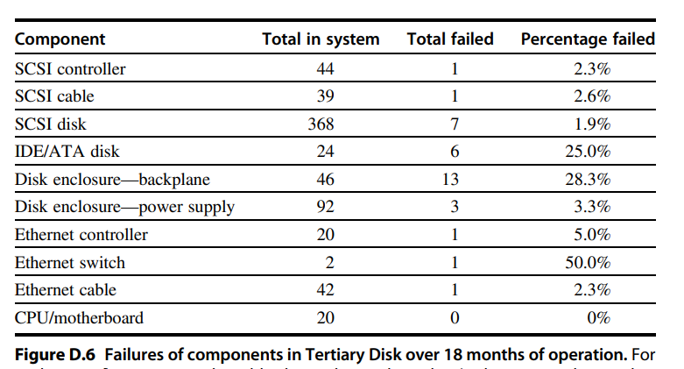
“three easy pieces”
Persistence
Not mentioned in CSAPP
What is persistence?
Memory vs disk
Even disk is not reliable sometimes

Slide 13
“three easy pieces”
Persistence
Not mentioned in CSAPP
What is persistence?
Memory vs disk
Even disk is not reliable sometimes
How to ensure persistence transparently?
Programmers generally don’t want to bother taking care of this!
General ideas
Redundancy
Checkpoint
Lineage

Slide 14
Process & thread
Why process?

Slide 15
Process & thread
Why process?
Virtualization
For the user: convenience
For the system: isolation
Between the user and physical devices
Among users
Fairness, security: brought by isolation
Concurrency
Parallelism among CPU cores/different CPUs/CPU and other processors
Parallelism between CPU and I/O devices

Slide 16
Process & thread
Why threads?
Light-weight (LWP, light-weight process)
Why?
Time, space
Process, thread, stackful coroutine, stackless coroutine
Computation-intensive vs I/O intensive
What about GPU-intensive?
Which to choose?
Parallel computing
Web server – I/O-intensive
Scientific computing – computation-intensive
Easy communication
Error-prone
Erlang: share nothing
Actor model
Go: communication sequential processes (CSP)
Do not communication by sharing memory; instead, share memory by communication

Slide 17
Process & thread
Key API (CSAPP recap)
Process
Thread

Slide 18
Process & thread
Key API (CSAPP recap)
Process
Fork, execve, wait/waitpid
Thread
Pthread_create, pthread_join, pthread_detach

Slide 19
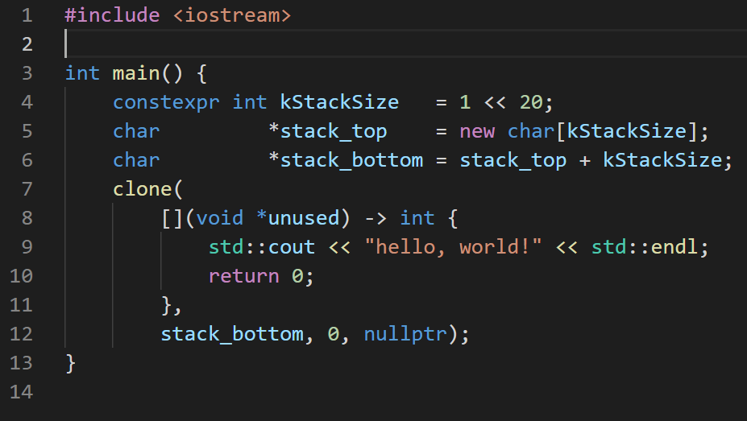
Process & thread
How to create threads in Linux?
First way: clone
Const
Read-only
Void f(const int a[]);
Constexpr
constant

Slide 20
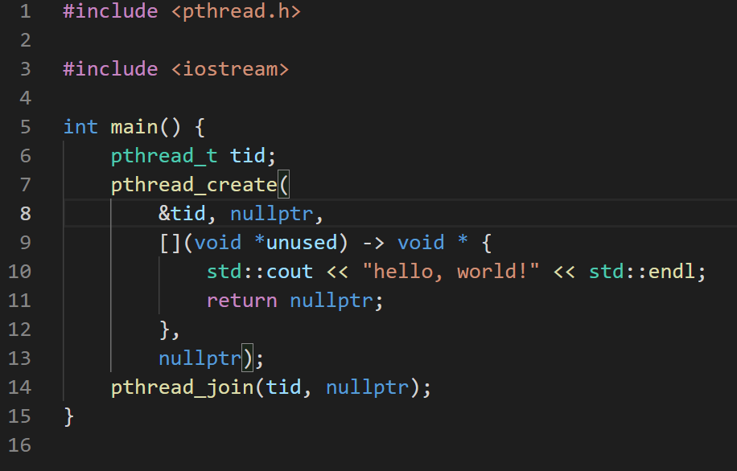
Process & thread
How to create threads in Linux?
Second way: pthread_create

Slide 21
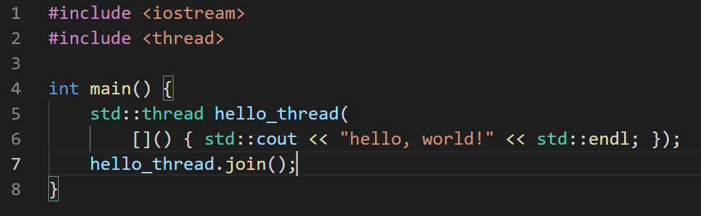
Process & thread
How to create threads in Linux?
Third way: C++ thread (since C++ 11)
Cross-platform
Every thread must be explicitly joined or detached
This trouble is (at least partly) solved by jthread

Slide 22
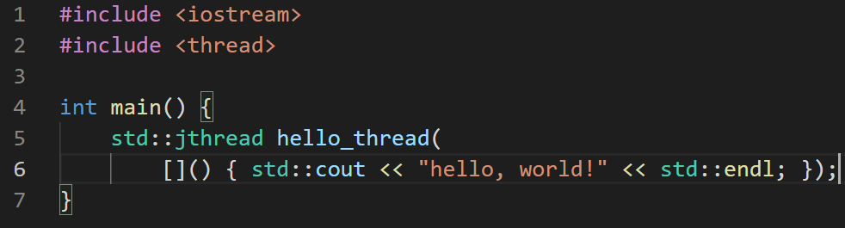
Process & thread
How to create threads in Linux?
Fourth way: C++ jthread (since C++ 20)
Cross-platform
Auto-join

Slide 23
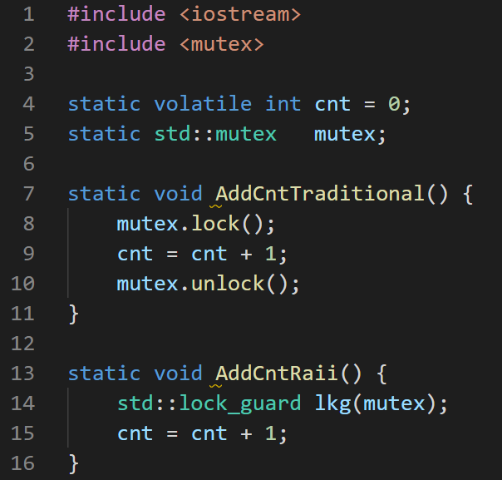
Process & thread
RAII (resource acquisition is initialization)
Life cycle of variables on the stack
binds the life cycle of a resource that must be acquired before use (allocated heap memory, thread of execution, open socket, open file, locked mutex, disk space, database connection—anything that exists in limited supply) to the lifetime of an object.
Heap memory
Shared_ptr, unique_ptr, weak_ptr
Make_shared, make_unique
array

Slide 24
Process & thread
Shared counter
Mutex
Semaphore
Atomic
C++ <atomic>
Std::atomic<int>
C <stdatomic.h>
_Atomic
On my WSL:
2 threads, atomic: 206ms
2 threads, mutex: 1295ms
3 threads, atomic: 365ms
3 threads, mutex: 1759ms
4 threads, atomic: 483ms
4 threads, mutex: 2689ms
5 threads, atomic: 613ms
5 threads, mutex: 3585ms
6 threads, atomic: 726ms
6 threads, mutex: 4517ms
7 threads, atomic: 830ms
7 threads, mutex: 5584ms
8 threads, atomic: 943ms
8 threads, mutex: 7494ms

Slide 25
Process & thread
Thread programming
Pthread
OOP style
The first argument can be considered as “this” pointer
tid
For creation, the second argument is “attribute”
Create, join, detach
Mutex:
int pthread_mutex_init(pthread_mutex_t *restrict mutex, const pthread_mutexattr_t *restrict attr);
int pthread_mutex_destroy(pthread_mutex_t *mutex);
int pthread_mutex_lock(pthread_mutex_t *mutex);
int pthread_mutex_trylock(pthread_mutex_t *mutex);
int pthread_mutex_unlock(pthread_mutex_t *mutex);

Slide 26
Process & thread
Thread programming
Pthread
OOP style
The first argument can be considered as “this” pointer
For creation, the second argument is “attribute”
Condition variable:
int pthread_cond_destroy(pthread_cond_t *cond);
int pthread_cond_init(pthread_cond_t *restrict cond, const pthread_condattr_t *restrict attr);
int pthread_cond_timedwait(pthread_cond_t *restrict cond, pthread_mutex_t *restrict mutex, const struct timespec *restrict abstime);
int pthread_cond_wait(pthread_cond_t *restrict cond, pthread_mutex_t *restrict mutex);
int pthread_cond_broadcast(pthread_cond_t *cond);
int pthread_cond_signal(pthread_cond_t *cond);

Slide 27
Process & thread
Thread programming
C++ thread
Thread
Jthread (since C++ 20, g++ 10 or later required)
Auto join
RAII (Resource Acquisition Is Initialization)

Slide 28
Process & thread
Data-level parallelism
Openmp
#pragma omp parallel for
Fixed iterations
Gcc: -fopmmp
Clang: -fopenmp=libomp

Slide 29
Process & Threads
Process model and implementation
Privileged arch – trap handling
Risc-v
Privilege mode: M(machine)>S(supervisor)>U(user)
Privileged instruction and registers (CSR)
Mret, sret, wfi (wait for interrupt), sfence.vma
Trap handling
Memory addressing
Event
Asynchronous
Three sources
External
Interrupt
Timer
Timer interrupt
Software
Interprocessor interrupt (implemented by the HW)
Signal (implemented by the OS)

Slide 30
Process & Threads
Process model and implementation
Privileged arch – trap handling
Event
Asynchronous
Three sources
External
Interrupt
Timer
Timer interrupt
Software
Interprocessor interrupt (implemented by the HW)
Signal (implemented by the OS)
Speedup
User-level interrupt
Interrupt vs polling

Slide 31
Process & Threads
Event
Synchronous
System call
Fault
Abort
Speedup
Asynchronous system call
Everything is asynchronous in Go
Coroutine
User-space->light-weight
Asynchrony
Page fault: work stealing

Slide 32
Process & Threads
Thread model and implementation
Difference between processes and threads
Linux vs windows
Clone
Linux: task_struct
Kernel threads, user threads, and the hybrid implementation
Coroutine
Stackful coroutine, stackless coroutine
Why is coroutine more light-weight in terms of both time and space?
Fewer and cheaper context switch
Asynchrony
Cutting-edge development
Cooperation between OS and PL

Slide 33
Process & threads
Scheduling
Different priority
Round robin
Multi-core
Affinity
Load balance
Heterogeneity
Intel Alder Lake
ARM big.LITTLE
GPU
Cluster

Slide 34
Process & threads
IPC
CSAPP recap
Wait/pthread_join
Signal
Shared memory, e.g., mmap
File
Socket
Pipe
Anonymous pipe
Named pipe
Synchronization mechanisms

Slide 35
Process & thread
Synchronization
Why is synchronization needed?
Concurrency
Not every interleaving of control flow will lead to desirable results
Thread safety
Shared mutable state
Synchronization mechanisms
Semaphore
Avoid as possible
Mutex + condition variable / monitor
Channel
Actor model
Thread-safe data structure

Slide 36
Process & thread
Classic synchronization problems
Dining philosophy
Mutex lock ordering rule
Producer-consumer and its generalization
Thread-safe queue
Multi-queue (priority)
Non-blocking
A release version: pool: put & get, identical items -> multi-threaded malloc
Reader-writer and its generalization
Capacity
Priority
Fairness

Slide 37
Process & thread
Peterson’s algorithm
Dekker’s algorithm
Memory consistency

Slide 38
Process & thread
The final exam problem
Three solutions to the producer-consumer problem
Semaphore
Mutex + condition variable
Spinlock
Busy waiting

Slide 39
Process & thread
Synchronization
Deadlock
Detection
Avoidance
The essence of the ostrich algorithm
Amdahl’s law
Make the common case faster

Slide 40
Memory management
Privileged arch – memory addressing
Segmentation vs paging
Virtual address -> physical address
Hybrid
Segment addressing vs segmentation
Former: calculating virtual address
Latter: Virtual address -> physical address
Why is segmentation not favored nowadays?
External fragments
Dynamic
Implementation complexity

Slide 41
Memory management
What can be mapped in the address space?

Slide 42
Memory management
What can be mapped in the address space?
Main memory
Disk
Swap space
File (mmap)
ROM
Other I/O device
Mapping of I/O device
Separate address or within the address space
GPU VRAM (video RAM)
AMD Smart Access Memory

Slide 43
Memory management
Page replacement algorithm
Relationship with scheduling

Slide 44
Memory management
Page replacement algorithm
Relationship with scheduling
spatial multiplexing vs temporal multiplexing

Slide 45
Memory management
Three-level memory allocation
Physical page -> virtual page -> area
OS
Area -> block (e.g., malloc)
PL
Block -> field
PL

Slide 46
File system
File operations

Slide 47
File system
File operations
Create/delete
Open/close
Connection-oriented vs connectionless
TCP vs UDP
Read/write
File vs mmap
Stream vs memory
Flush
Seek
Truncate
Fsync
Get attribute, set attribute, rename

Slide 48
File system
File types in Linux
Regular file
Directory
Pipe
Socket
Hard link
Soft link
Device
Block device vs character device
Disk vs socket

Slide 49
File system
Input: linear sequence of fixed-size blocks (logical blocks)
This abstraction is provided by I/O device management
File system layout
I-node, file
Bootstrap
Hierarchy
Pathname
Depend on the underlying storage medium
HDD vs SSD
RAID
Redundant array of inexpensive disks
Performance reliability
Went through significant changes in every modern OS

Slide 50
I/O device management
Disk
HDD vs SSD
Timer
Timer vs clock
Keyboard, mouse, monitor
What is a driver?
Does CPU need a driver?

Slide 51
coroutine
User-level thread
Assign coroutines to threads
Classification
Stackful
Go
Goroutine + channel + asynchrony
C++ boost
Stackless
Rust, kotlin (kotlin-jvm no auto-assignment), C++23
Continuation
Python generator
Suspendable function
Suspendable point
Information to be saved (continuation)

